Slide 1
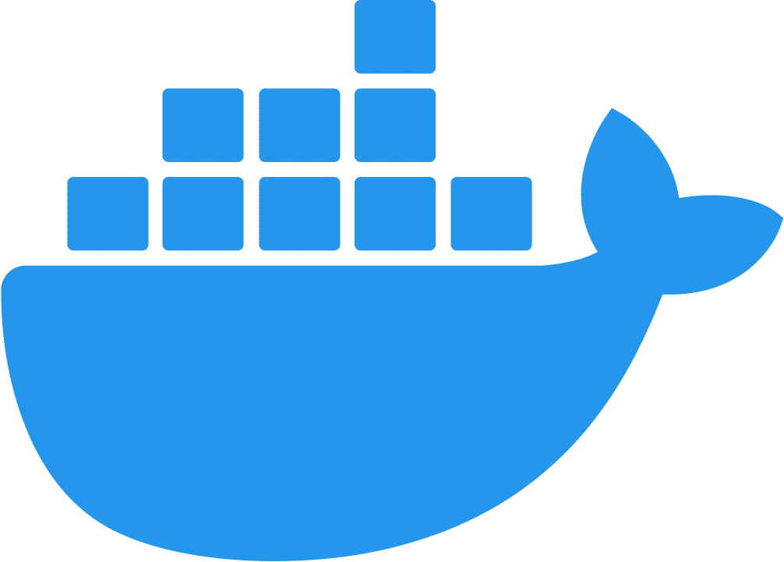
Rapid Prototyping with the help of Docker
Notes:
Good afternoon everyone!
Welcome to my talk on Rapid Prototyping with the help of Docker!
Shortly into the presentation I’ll be talking about Docker.
Just in case it’s needed, I created a slide that will give a quick overview of Docker if there are people here today that don’t know what it is or how it works. I’ll skip the slide if everyone’s familiar with it.
Don’t be embarrassed if you don’t know. That’s the whole reason why we’re here at a developer conference… to learn.
Maybe a show of hands… Does anyone not know what Docker is?
Would anyone want me to give a quick overview of Docker when we reach that slide?

Slide 2

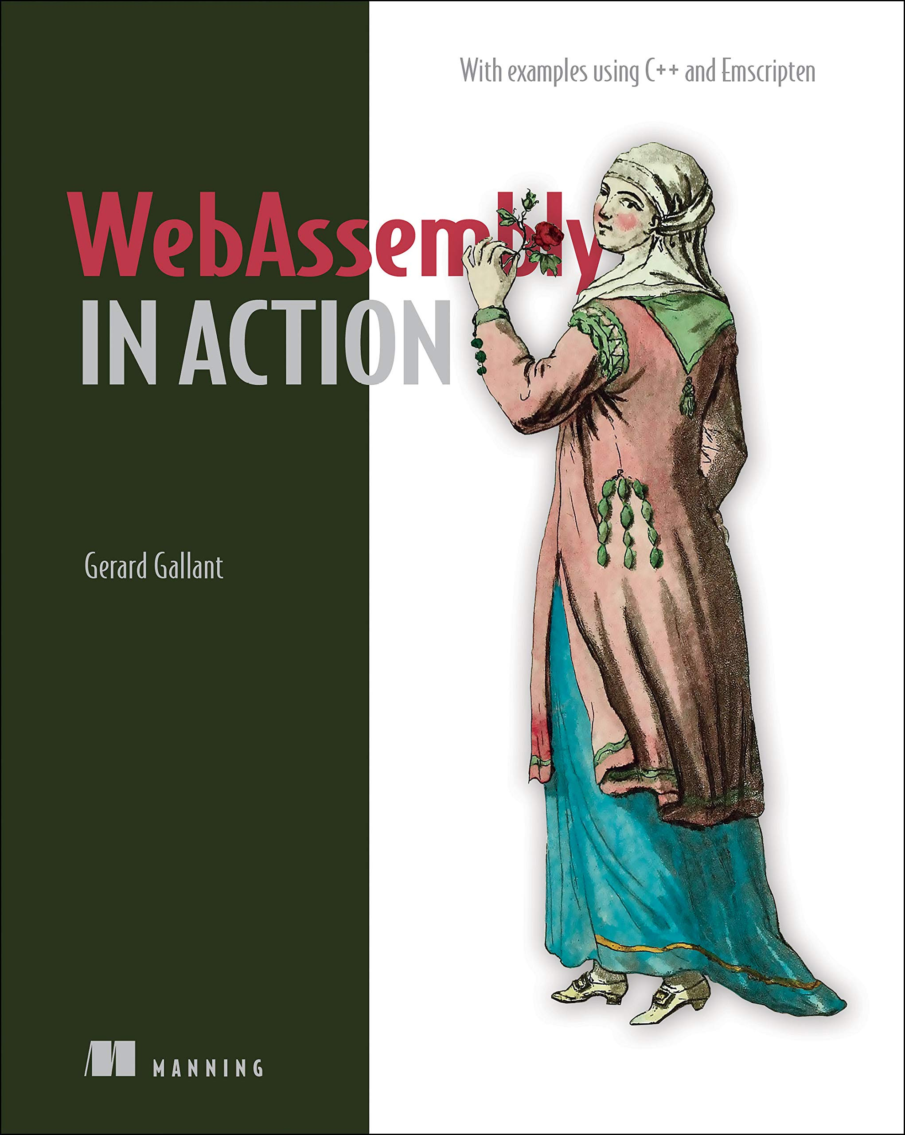


Gerard Gallant
CIO at Dovico Software
“WebAssembly in Action”
http://bit.ly/37zJbp5
@Gerard_Gallant
linkedin.com/in/gerard-gallant
Notes:
My name is Gerard Gallant.
I work at Dovico Software and currently wear a few hats.
CIO is a role that I’m expanding into but I’m also a senior software developer and architect.
Writing a book was a bucket list item so I’m pretty happy that I was given the opportunity to write a book with Manning Publications called “WebAssembly in Action”.
If you want to reach me, you can find me on Twitter or LinkedIn.

Slide 3
Outline
Why was a solution like Docker needed?
How we’re currently using Docker
How we might leverage containers next
Notes:
In this talk, I’m going to discuss the challenges that we faced when we looked into modernizing one of our products.
I’ll start with a quick overview of how our product was structured so that you understand why a solution like Docker was needed.
[click]
Then we’ll look at how we’re currently using Docker
[click]
And, finally, we’ll look at how we might leverage containers even more going forward

Slide 4
Where we were
Login
Timesheet
Users
Notes:
Quickly show Timesheet so that people can visualize what I’m talking about below
Looking at where we were…
Our main product, Dovico Timesheet, is a monolith. It was started back in the day using Active Server Pages and then we jumped to ASP.NET when that came out.
There are a variety of different technologies that have been used over the years so it takes time for new developers to get up to speed and it takes time to update the software in general.
If we just wanted to try something, the software needs to be rebuilt, tested, and deployed. That process isn’t quick.
We needed a better solution.

Slide 5
Creation of Modules
Apps &
Integrations
API Proxy
API
Users
Login
Timesheet
Modules talk to the API
through a Timesheet endpoint
Notes:
I started looking at our architecture to see what we could do…
[click to show api]
We had built an API so that apps and customer integrations would be possible but the API was created about 10 years after Timesheet was started so Timesheet itself doesn’t use it.
While looking at the architecture, an idea occurred to me…
[click to show module link]
- What if we allowed for client-side only views that could talk to the local API?
> Having it client-side only removes the potential security issues of code accessing files, memory, or session state data on the server that it shouldn’t
> The client-side code would only be things like JavaScript, CSS, HTML, images, and WebAssembly
- The API calls themselves would be the same as what an app or integration would use but the module would talk to a Timesheet endpoint instead. The Timesheet endpoint would just relay the call to the local API instance.
> This simplifies things for the module developer and adds security for users because the module doesn’t know about the user’s credentials. The Timesheet endpoint will specify them before passing the call along.
> This is also secure because, even if the module tries to access certain data, all API calls are restricted based on the logged in user’s permissions. The Timesheet endpoint is passing the local API the logged in user’s token so only information that person has access to will be returned.
- Finally, instead of a config file that forces all companies to have the same menu system, I created a table in the database for the views. The table indicates where the main file of the module is.
This is great!
All we need to do is add a module’s files to a folder under the solution and add a record to the database table and presto! A new view lights up without needing to recompile or deploy Timesheet!
Now we can test new ideas for features, try different UI frameworks like Bootstrap or React, and even test module ideas with specific customers by only turning on that view for them.
It’s a step forward but the issue that we now faced is that a developer version of this setup takes quite a bit of effort to configure before you can even start working on a module…
- You need to install a database engine, or pull a docker image, and then restore 2 databases
- You need to pull and compile the source code for 3 different solutions
- You need to set up 3 IIS applications
> There are 4 shown here but the API Proxy isn’t used by modules because Timesheet it talking directly to the local API
- Some configurations are needed in the databases
- And each app’s config files need to be adjusted so that everything talks together properly
If you’re fortunate, everything works on your first try and you don’t need to spend a bunch more time trying to figure out which configuration you forgot or messed up.
This is a lot of work to set it up even for one of our experienced developers never mind a summer student.
It’s also a showstopper if we wanted to open this up to third parties because we wouldn’t want to hand over our source code.
So…
How can we make the setup easier so that we can just start working on a module and how can we allow 3rd party development without giving them our code?

Slide 6
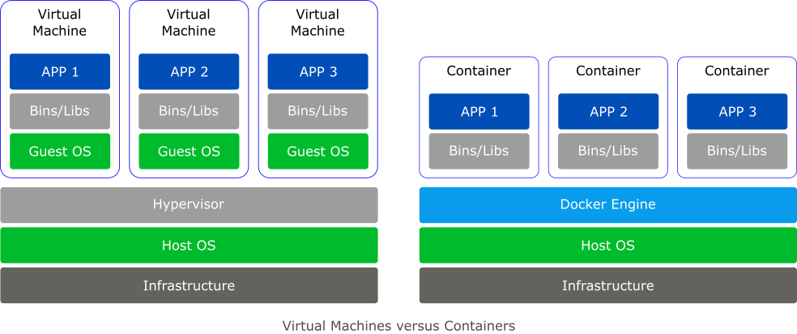
What is Docker?
Notes:
Docker is a platform that lets you build, deploy, run, and manage containers.
A container is a package that contains an application’s code and all of its dependencies, so that it can run quickly and reliably from one computing environment to the next.
Like a virtual machine (VM), containers are isolated and act as if they have their own file system, CPU, and RAM. Unlike a VM, however, they don’t have an OS. Instead, a container shares the kernel of the host OS.
Not having an OS reduces the container’s size. It also allows a container to start faster and be much more efficient because there are fewer system resources needed to run it. Because of the smaller size and fewer resources compared to a VM, additional instances of the application can be run with the same hardware.
Although the image shows containers and VMs as being separate, you could implement a solution where one or more of your VMs have containers.

Slide 7
Can Docker Help?
Windows Container with IIS
Linux Container with SQL Server
Developer
Login page
Timesheet
API
OS 1
OS 2
Notes:
We had started to use Docker internally for development needs.
For example, I no longer install a database engine on my laptop. I just pull a Docker image with the database engine version I need.
Rather than passing around developer databases, I set up a docker image with some dev databases that are preconfigured to make getting started with building our solutions easier.
Could docker help us here?
[click to show the Windows container]
Based on our software stack, we would need a Windows Docker image because Timesheet uses the ASP.NET Framework which needs IIS and both technologies are Windows-specific.
It’s not the end of the world because this is only intended for developers but Windows images tend to be quite a bit bigger than Linux images.
Unfortunately, I discovered that MS discontinued support for the Windows Docker Image of SQL Server and only Linux is supported now.
[click to show the Linux container]
This throws a wrench into my plans because you can’t have Windows and Linux containers running simultaneously on the same machine.
This could be a multi-OS setup [click to show the OS labels] but that’s still complicated and not every developer is going to have a second machine to network with especially if they’re working from home in this new remote/hybrid world.
At the same time, it’s not that hard to copy files out of an image. Down the road I’d like to open this up to 3rd parties so that they can create modules too. What if they realize a full version of Timesheet is in the Docker image? They could copy it out, set it up on their own servers without us knowing and without paying us for it.
These are some pretty big hurdles to overcome and I wasn’t sure if containers could help after all
As I was thinking about this though, something dawned on me

Slide 8
Timesheet Simulator
Apps &
Integrations
API Proxy
API
Users
Login
Timesheet
Timesheet Simulator
Developer
Notes:
Really… we only need a way to develop a module so that it works exactly the same way on the developer’s machine as it will in production. Ideally, it would look and feel like you’re in Timesheet.
We don’t really need the full version of Timesheet with the databases and everything else in the docker container.
What if we had a Timesheet Simulator that just talks to the normal API endpoint but the module interacts with it the same as it would with Timesheet in production?
[click to show the simulator and its interaction with the api proxy]
With the simulator, you create enough of the Timesheet UI so that you can see how your module will look in Timesheet and enough of the setup that you don’t need two sets of JavaScript (one for development and the other for prod where you only find out if you messed up an endpoint or something once deployed)
The simulator approach is what I decided to look into.
[Switch to the Dovico Website]

Slide 9

35% off everything (the code expires on April 21st)
https://github.com/cggallant/confoo-2023

